Slide 1
Introduction to Object-Oriented Design for Scientists
RSE Webinar – August 29th, 2018
Notes:
Explain that you can take questions in the middle of the presentation, as long as we can keep it short. Otherwise, after presentation.
Welcome everyone and thanks RSE and Andy for the opportunity.
I collaborated with professors from OR department and see that when we adopt SE techniques in these areas when developing software, it really helped. Actually, we continue collaboration and try to impact on coding practices in this field.
This presentation, I hope it will be helpful for you to spark interest in object oriented design because we have seen many benefits by adopting it.

Slide 2
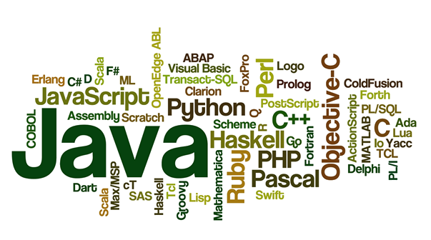
Programming languages
Notes:
We have lots of programming languages nowadays. Mostly general purpose languages, meaning that anything can be implemented with them. And some specialized languages for specific topics, like mathlab, R etc.
The thing is not about which language we choose. It is about the complexity of the programs we create.

Slide 3

A non-complex program
Notes:
A program is simple when it is short and small.

Slide 4
How about longer ones?
Chrome browser: 17 millions LOC (lines of code)
Office 2013: 45 millions LOC
Facebook: 60 millions LOC
Notes:
One can’t just put all the lines sequentially and expect someone to understand it.
First of all, it is impossible.
Second of all, it is torture.

Slide 5
There are some solutions…

Slide 6
When things get bigger → Modularize
Notes:
We can modularize by using functions. Grouping some of the stuff.
So our programs will be more understandable.

Slide 7
Modularize even more…
Notes:
We can go even further and make more modular by creating parametrized functions.

Slide 8
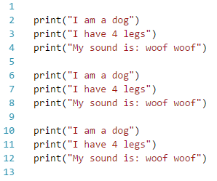

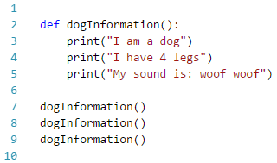
Modularizing
Notes:
Now you may be thinking… enough of the lines, give me something concrete…
Now I want to do this 3 times. Of course the solution is this, right [CLICK]
I think we should be smarter than that. [CLICK]
And maybe one can do go one step further and do this in a loop

Slide 9
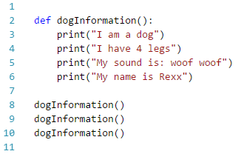
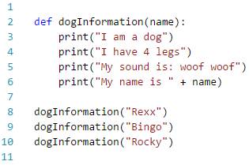
Modularizing - parametrized
Notes:
Now let’s add more of the dog’s attributes. Now we also want to write the dog’s name. [CLICK]
Of course not all dogs are Rexx, so here it is. [CLICK]

Slide 10
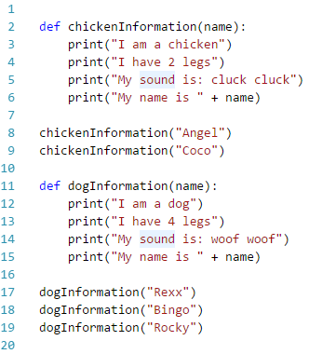
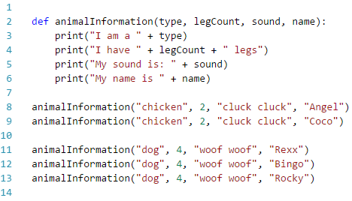
Modularizing – more parametrized
Notes:
Now I want to print another animal information
[CLICK] Tadaa chicken
But I didn’t like something in this code.
We have a lot of repetition here and here. [SHOW: I am I have My name is]
[CLICK] Now it is better
But still, why should I write 2 or 4 everytime? Or Woof woof or “dog” in that sense.

Slide 11
Epiphany
Wouldn’t it be nice if there is special structure that:
Knows what kind of an animal it is.
Knows how many legs it has.
Can make sound by itself.
Has a name.
Notes:
So that I don’t need to write everything down from scratch every time I need a dog.

Slide 12
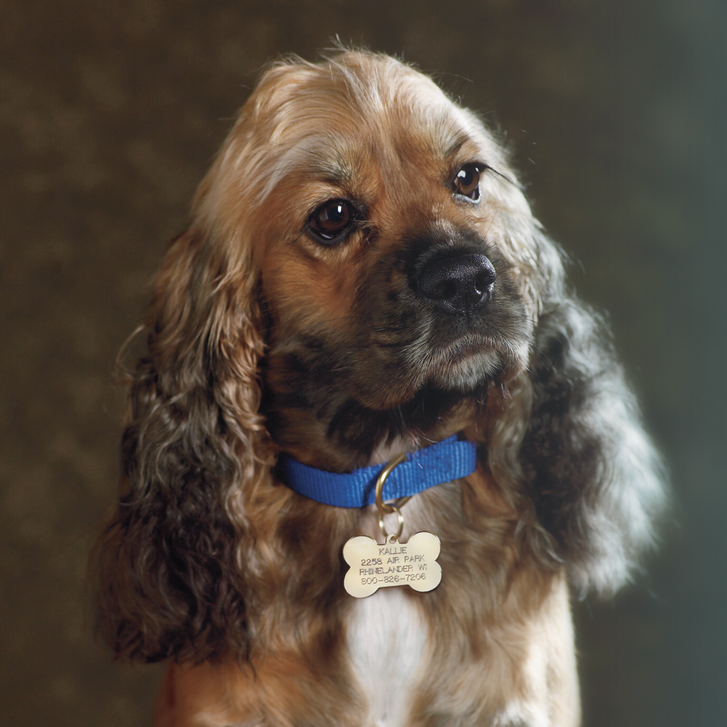
Epiphany
Notes:
So we are basically talking about a dog?
Has name, knows how many legs it has, can make sound itself.

Slide 13
In object-oriented design, we are copying the real life structure in our application.
Notes:
And this is for a very good reason.

Slide 14
Harold Abelson In his book SICP: Structure and Interpretation of Computer Programs (with Jay Sussman)
First, we want to establish the idea that a computer language is not just a way of getting a computer to perform operations but rather it is a novel formal medium for expressing ideas about methodology.
Thus, programs must be written for people to read, and only incidentally for machines to execute.
Notes:
So actually, we are writing the programs for ourselves. The computer will do whatever it is given as an input.
It doesn’t need to have meaningful names, functions, classes, objects, variables. It just needs some instructions.
[CLICK]
Languages are for us!

Slide 15
Epiphany
Wouldn’t it be nice if there is special structure that:
Knows what kind of an animal it is.
Knows how many legs it has.
Can make sound by itself.
Has a name.
Object-Oriented Design
Notes:
So we had this epiphany, and the system we are looking for is object-oriented design.
A.k.a.
Object-oriented programming
Object-oriented methodology
Object-oriented paradigm
Object-oriented design and analysis

Slide 16
Object-oriented design
Side
Area = side*side
Height
Base
Area = (height*base)/2
height
Side
base
Notes:
Basically, we have objects that know:
Their attributes
Their operations
Whenever, I need a square or triangle, I will use them and ask them.

Slide 17
Object identification
Car, glass, bike, bus
Dog, cat, person, laptop
Running, walking, making a sound etc… ?
Side, height, numberOfLegs etc… ?
Notes:
[CLICK] All can be objects
[CLICK] Again, can be objects
[CLICK] No, these are not objects!
These are actions (methods/operations) that can be done by an object
Like a Rectangle can compute its own area
A people can run.
[CLICK] No, these are not objects!
These are properties (attributes) that can be owned by an object
Like side of a Rectangle.
Numberoflegs of a Person.

Slide 18
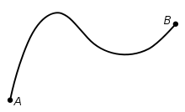

Everything can be an object…
It just depends on the context!
Distance between two cities can be an object
Relationship between two people can be an object
Notes:
If we solve a problem based on mostly these. Then definitely.

Slide 19
Object-oriented languages
Most modern languages support object-orientation now
Java
C++ (C with classes)
C#
Python
Even Fortran
Any many more

Slide 20
Now, various languages support object-orientation, there should be a way to represent this system regardless of the language we use.
Notes:
And this is what brings us to UML

Slide 21

UML
Notes:
So it is basically a set of diagrams in order to be at the same page while designing systems agnostic than programming languages.

Slide 22
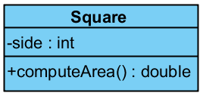
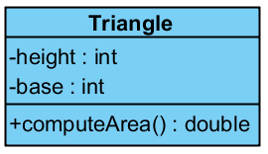
UML basics
Side
Area = side*side
Side
Height
Base
Area = (height*base)/2
height
base

Slide 23
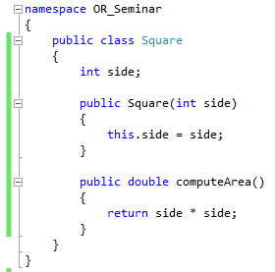
Class in C#
Notes:
A class looks syntactically different in different languages, but essence is the same. [CLICK]
Here is a class in C#.
BUT WAIT.

Slide 24

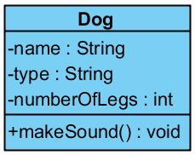


WAIT!
We were talking about objects, now what the heck is a class?
Notes:
This is an object, [CLICK] this is an object, [CLICK] this is an object. [CLICK]
Now this is a class. You got the idea.
Basically, we get the properties that all the dogs have and define a Dog class with them.
A class is a generalization of objects.
And objects are just instances of the class.

Slide 25
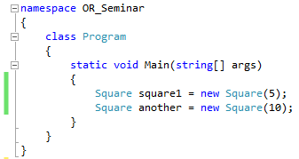
Objects from classes
Constructor
Now, we can create objects
Notes:
Constructors are getting this general information and creates an instance out of it.

Slide 26
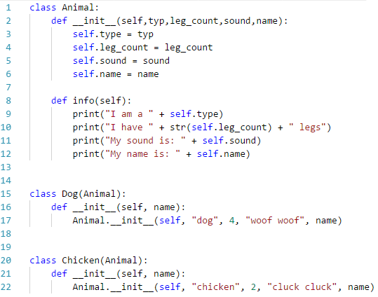

How it affects our code?
Notes:
You remember we had this code piece that’s has lots of duplicates.
Let’s see if how it will look like after OOD is applied.
Of course, we would have classes for animals, dogs, and chickens and some properties attached to them.
[CLICK]
And this is how they are created as an object. Remember creating objects from classes. [CLICK]

Slide 27
Concepts and design principles in OOD
Concepts:
Encapsulation
Inheritance
Polymorphism
Cohesion
Coupling
Principles
Open-closed principle
Single Responsibility principle
Liskov substitution principle
Interface segregation principle
Dependency inversion principle
Notes:
Of course, no fancy approach is without its consequences. OOD has lots of principles and concepts.
If we don’t use these concepts and obey these principles, we aren’t coding in proper object-oriented way. And we are basically coding in the old way but with extra complexities.
It is like your car can go 100 kilometers per hour but you insist to go with a 30 on a highway because you don’t want to mess with the car and scare about what happens if something goes wrong.

Slide 28
Encapsulation
Protecting your information from being used incorrectly

Slide 29
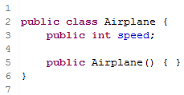
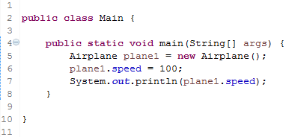
Encapsulation - example
Problem?
Notes:
Now that anyone can change the speed of a plane,
But what if speed is out-of-range? Or invalid? Or maybe you should do just some adjustment to the speed before setting?

Slide 30
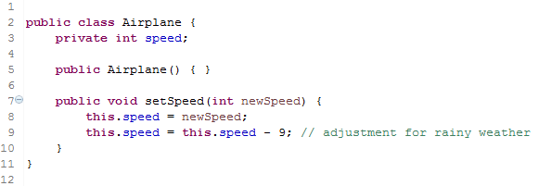
Encapsulation - example
SOLUTION?
Notes:
Now what is the solution?
OOD gives us this visibility modifiers: public, private etc. So that any attribute can be hidden from public if needed.
Now speed will be adjusted whenever set externally.

Slide 31
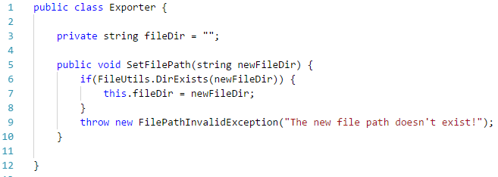
Encapsulation – relevant example

Slide 32
Inheritance
A class can inherit properties and operations from another class.

Slide 33
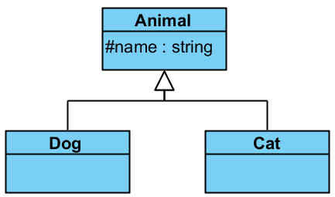
Inheritance - example
Notes:
So, you remember our Dog and Chicken example. They were both animals.
So why shouldn’t we create a common class for the common properties/methods of this two animals.

Slide 34
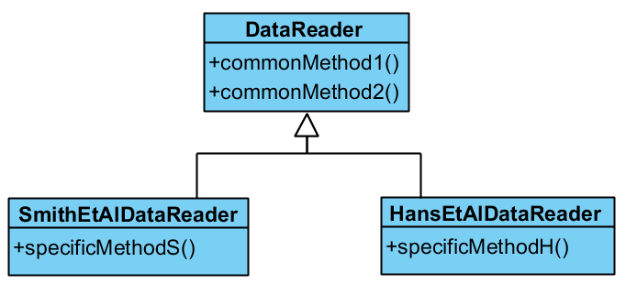
Inheritance – relevant example
Notes:
So you have two data formats to read into your program, and the functions that do the read is somewhat similar.

Slide 35
Polymorphism
Having different forms of same operations.

Slide 36
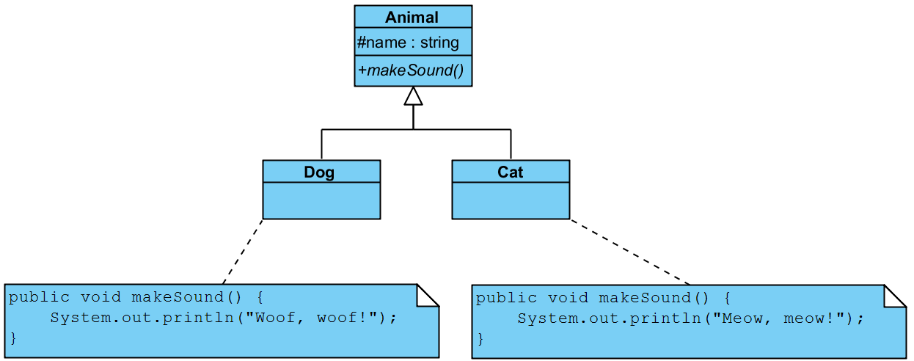
Polymorphism - example

Slide 37
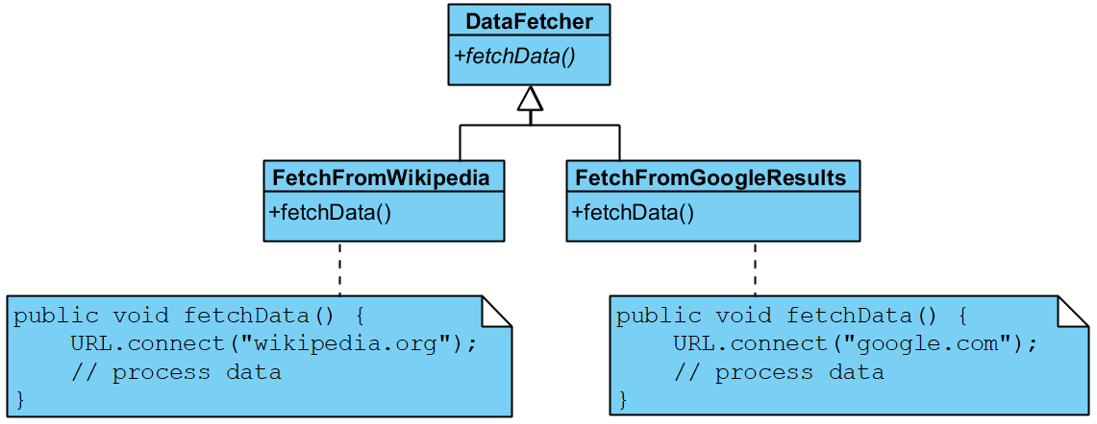
Polymorphism – relevant example

Slide 38
Cohesion
A class should do one thing really well and should not try to do or be something else.

Slide 39
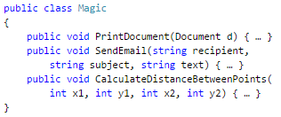
Cohesion - example
Notes:
If a class has methods for:
Printing a document
Sending an email
Working with trigonometric functions
How should we name it? Complicated, right?
Strong cohesion is good and a desired feature.
It means: all methods of a class are more or less related.
-A math class for example, which can compute sqrt, power, exp, cos etc.

Slide 40
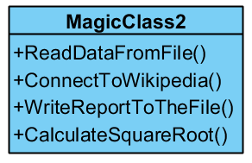
Cohesion – relevant example

Slide 41
Coupling
The extent to which classes depend on one another.
A class should work independently without being coupled too much to other classes, which help making them modules and available on demand.

Slide 42
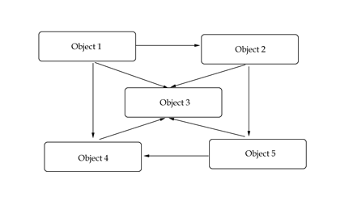
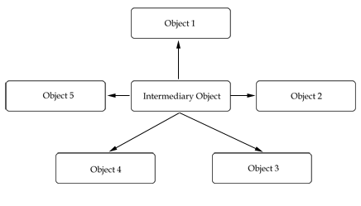
Coupling - overview

Slide 43
Open-Closed Principle
Classes should be open to extension, but closed for modification.

Slide 44
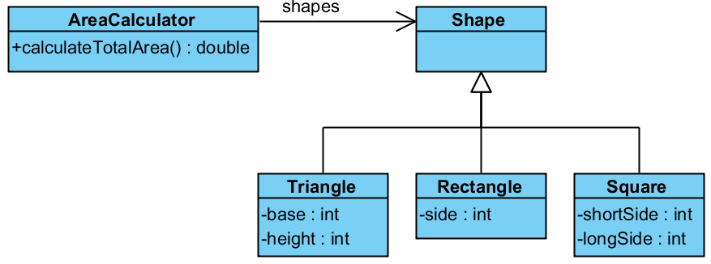
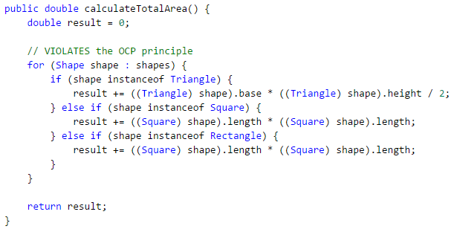
Open-closed principle - example
Problem?
Notes:
Whenever we add a new shape to the system, we should go and modify this method of area calculator.
So, this class [AreaCalculator] is not closed to modification.

Slide 45
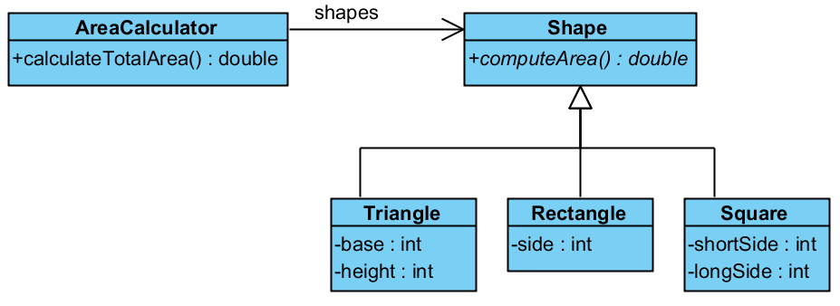
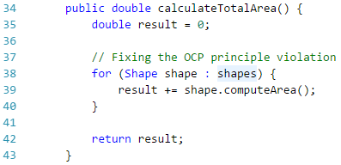
Open-closed principle - example
SOLUTION?

Slide 46
Single Responsibility Principle
Every object in the system should have one responsibility. Therefore, one reason to change.
Notes:
This doesn’t necessarily mean they have to have one method.

Slide 47
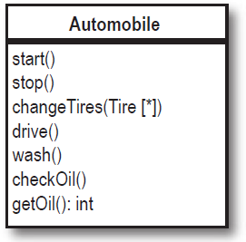
Single responsibility principle - example
Problem?
Notes:
Usually the violation of this principle can be identified by asking:
Can _______ _________ itself?
Example: Can Automobile changeTires itself?
If it is no, it is violating SRP.

Slide 48
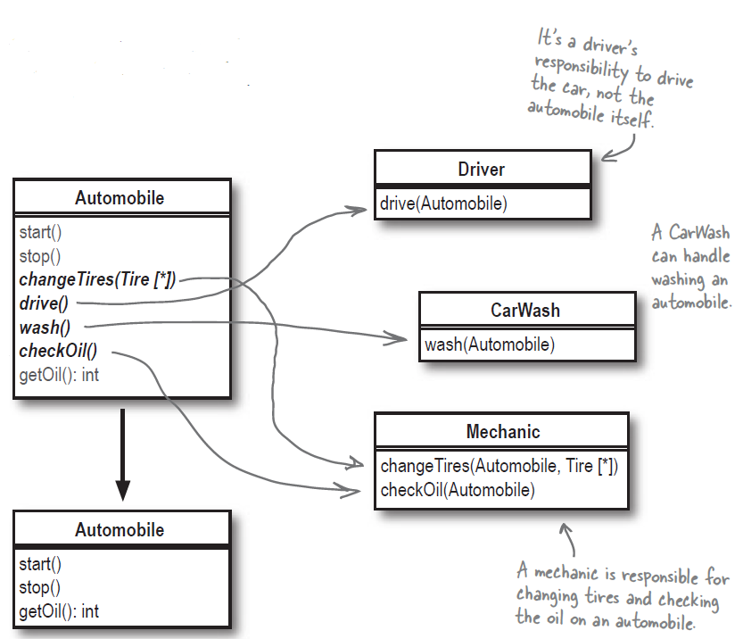
Single responsibility principle - example
SOLUTION?

Slide 49
Interface Segregation Principle
A class should never be forced to have some unnecessary methods.

Slide 50
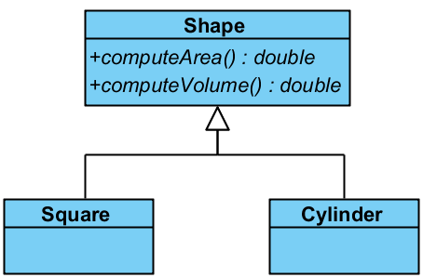
Interface segregation principle - example
Problem?
Notes:
We force Square to have a computeVolume method, which it doesn’t have!
Because it inherits from Shape.

Slide 51
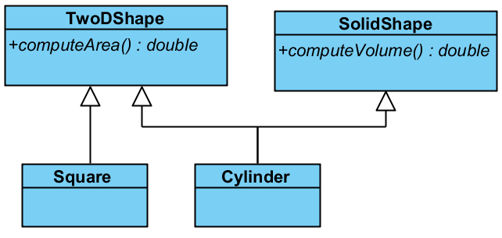
Interface segregation principle - example
SOLUTION?
Notes:
We force Square to have a computeVolume method, which it doesn’t have!
Because it inherits from Shape.

Slide 52
So, what can we achieve from this? – Sample scenarios
Read data from various sources but our program can stay the same
Easily switch between different algorithms on the same data
Make any module work independent from others
Make the output of the project independent from the data or the algorithm itself
Test the correctness of each class independently
Model the problem in a human-readable way
And most importantly, reuse and maintain your application better.
Future-proof.

Slide 53
Conclusion
Object-oriented programming provides very flexible structures for our programs.
It can be applied in many languages, as long as the language supports object-orientation.
If we obey the principles, it will be an actual system.
Otherwise, it is just the same code with classes and additional complexity.
Object-oriented system is not a perfect system and it has its own flaws. But it is still the best system.

Slide 54
Always strive for the best design.

Slide 55
hergin@bsu.edu http://www.cs.bsu.edu/~hergin
Thanks & Questions

Slide 56
Some resources
Object-oriented programming with C# (The book itself is nice and free, chapter 20 is OOP): http://www.introprogramming.info/english-intro-csharp-book/read-online/
For new starters to OOP, this book is fun: https://www.amazon.com/Head-First-Object-Oriented-Analysis-Design/dp/0596008678
Detailed explanation, nicely done, 2 pages (Java):
https://www.ntu.edu.sg/home/ehchua/programming/java/J3a_OOPBasics.html
https://www.ntu.edu.sg/home/ehchua/programming/java/J3b_OOPInheritancePolymorphism.html
Same as above but with C++:
https://www.ntu.edu.sg/home/ehchua/programming/cpp/cp3_OOP.html
Even though, there are a lot of resources. I suggest to work with someone who you can ask questions immediately. Because OOP requires a change of mindset.

